Slide 2
BIPOLAR JUNCTION TRANSISTOR
INTRODUCTION:The transistor is a main building block of all modern electronic systems
An amplifier is a circuit that is used to increase the strength of an ac signal
Basically, there are two types of transistors
Bipolar junction transistor
Field effect transistor

Slide 3
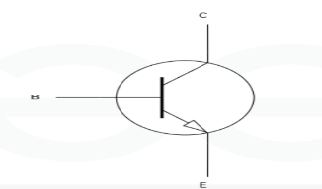
BJTs are of two types:
NPN
PNP
NPN Transistor
In NPN transistor left and right semiconductor are N-type and middle semiconductor is P-type and the direction of the current outside, towards the Emitter as shown in fig.

Slide 4
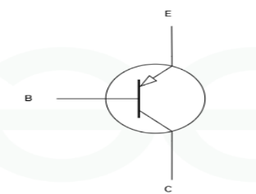
PNP Transistor:In PNP transistor the N-type diode is sandwich between the two P-type semiconductor and the direction of the current is going into the p-type as shown in below fig

Slide 5
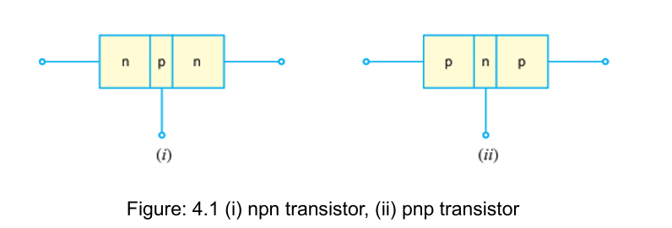

Slide 6
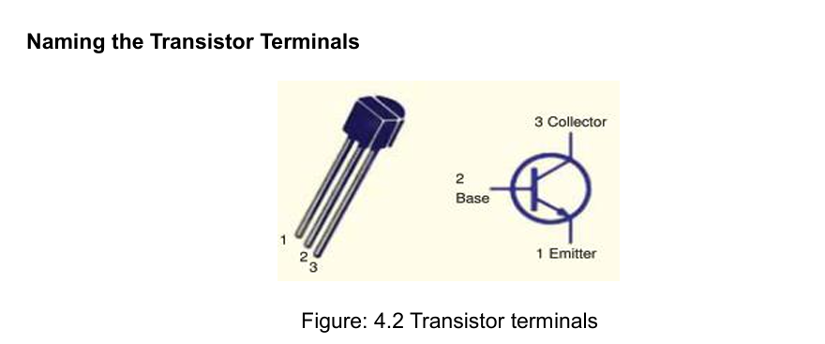

Slide 7
A transistor (pnp or npn) has three sections of doped semiconductors.
The section on one side is the emitter and the section on the opposite side is the collector.
The middle section is called the base and forms two junctions between the emitter and collector.
(i) Emitter: The section on one side that supplies charge carriers (electrons or holes) is called the emitter.

Slide 8
(ii) Collector: The section on the other side that collects the charges is called the collector
(iii) Base: The middle section which forms two pn-junctions between the emitter and collector is called the base.

Slide 9
Some Facts about the Transistor
The transistor has three regions, namely; emitter, base and collector
The emitter is heavily doped so that it can inject a large number of charge carriers (electrons or holes) into the base.
The base is lightly doped and very thin; it passes most of the emitter injected charge carriers to the collector.
The collector is moderately doped.
The emitter diode is always forward biased whereas collector diode is always reverse biased.
The resistance of emitter diode (forward biased) is very small as compared to collector diode (reverse biased).
Therefore, forward bias applied to the emitter diode is generally very small whereas reverse bias on the collector diode is much higher

Slide 10
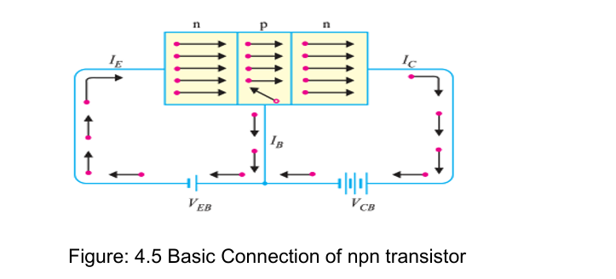
Transistor Action

Slide 11
Transistor Action
(i) Working of npn transistor, In Fig. 4.5 shows the npn transistor with forward bias to emitter-base junction and reverse bias to collector-base junction.
The forward bias causes The electrons in the n-type emitter to flow towards the base.
This constitutes the emitter Current IE. As these electrons flow through the p-type base, they tend to combine with holes.
As the base is lightly doped and very thin, therefore, only a few electrons (less than 5%) combine with holes to constitute base current IB.
The remainder (more than 95%) cross over into the collector region to constitute collector current IC
In this way, almost the entire emitter current flows in the collector circuit. It is clear that emitter current is the sum of collector and base currents i.e.IE= IB + IC

Slide 12
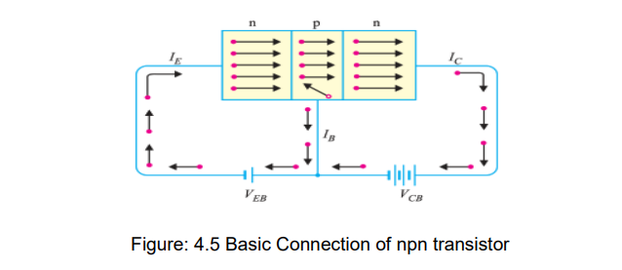

Slide 13
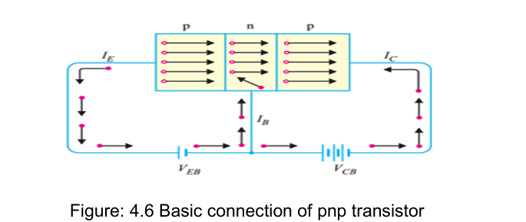

Slide 14
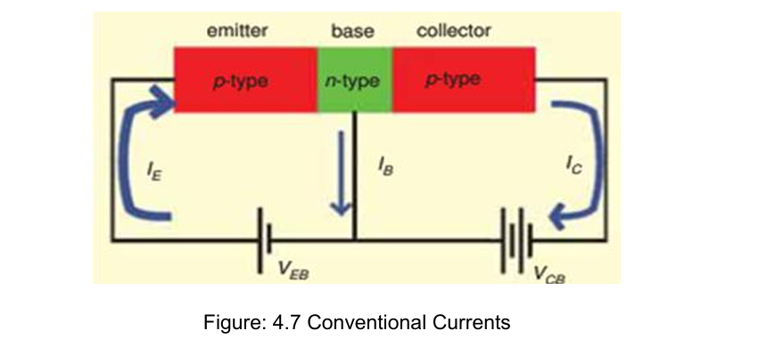

Slide 15
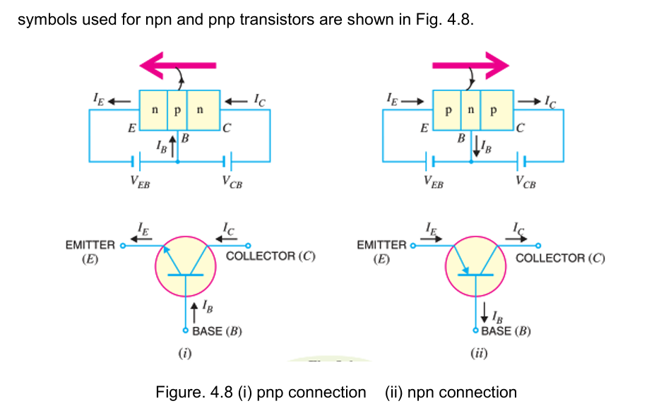

Slide 16
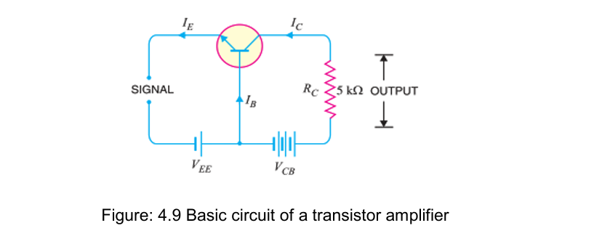
Transistor Circuit as an Amplifier

Slide 17
Transistor Circuit as an Amplifier
A transistor raises the strength of a weak signal and thus acts as an amplifier. Fig. 4.9 shows the basic circuit of a transistor amplifier.
The weak signal is applied between emitter-base junction and output is taken across the load RC connected in the collector circuit.
In order to achieve faithful amplification, the input circuit should always remain forward biased.

Slide 18
Types of BJT Amplifiers
BJT works in the 3 configuration as mention below :
Common Emitter (CE) Configuration
Common Base (CB) Configuration
Common Collector (CC) Configuration
Common Emitter (CE) Configuration
The emitter terminal in this setup is shared by the input and output.
It provides voltage gain and high power gain.
Commonly used for amplifying weak signals.

Slide 19
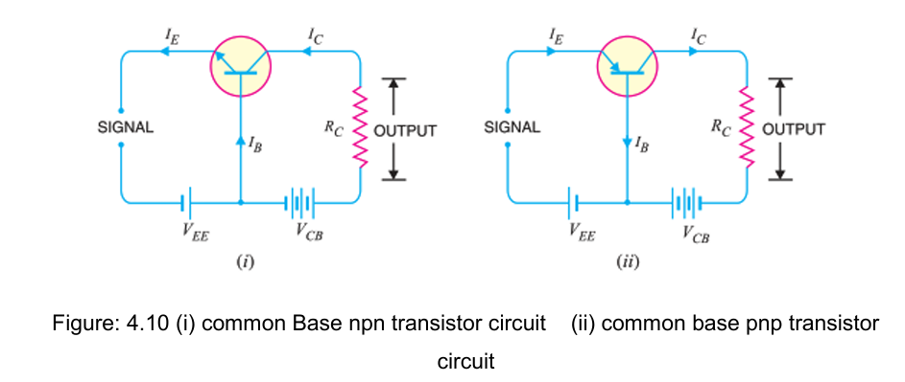
Common Base Configuration

Slide 20
Common Base Configuration
In this circuit arrangement, input is applied between emitter and base and output is taken from collector and base.
Here, base of the transistor is common to both input and output circuits and hence the name common base connection.
Current amplification factor (α): It is the ratio of output current to input current. In a common base connection, the input current is the emitter current IE and output current is the collector current IC.

Slide 21
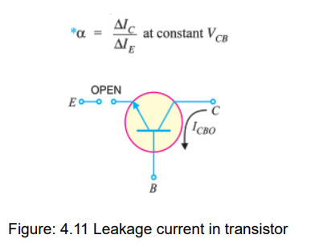
Practical values of α in commercial transistors range from 0.9 to 0.99

Slide 22
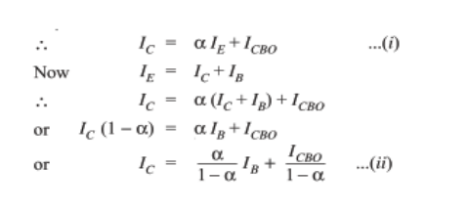

Slide 23
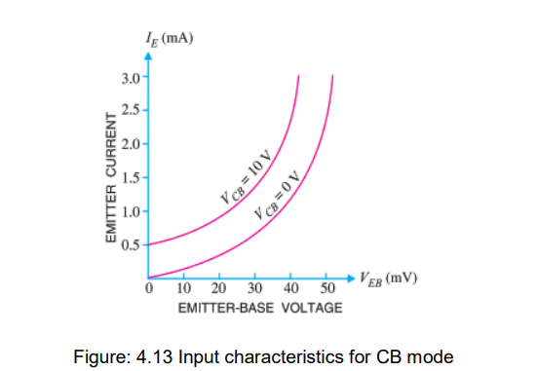
Characteristics of Common Base Connection

Slide 24
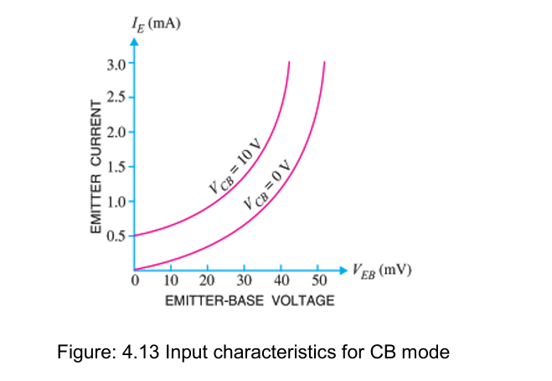

Slide 25
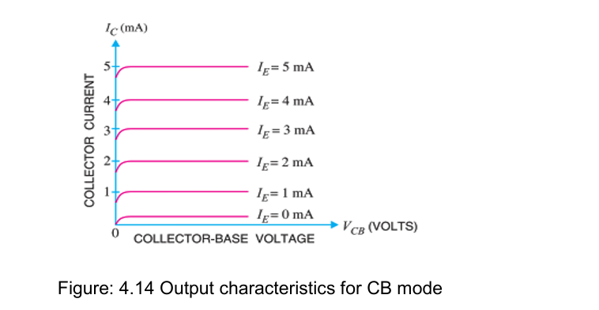

Slide 26
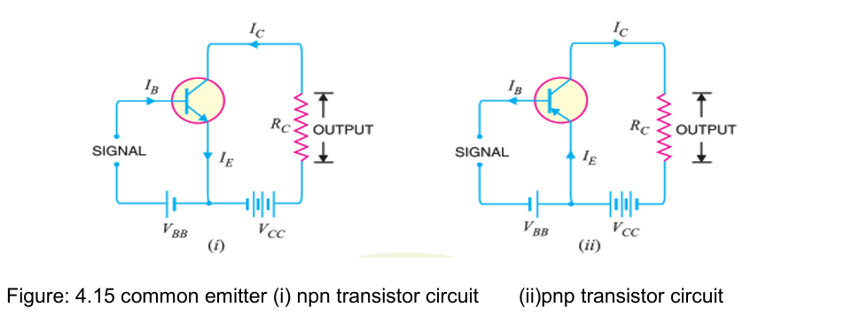
Common Emitter Configuration

Slide 27
Common Emitter Configuration
In this circuit arrangement, input is applied between base and emitter and output is taken from the collector and emitter
Here, emitter of the transistor is common to both input and output circuits and hence the name common emitter connection.
Fig. 4.15 (i) shows common emitter npn transistor circuit whereas Fig. 4.15 (ii) shows common emitter pnp transistor circuit.

Slide 28
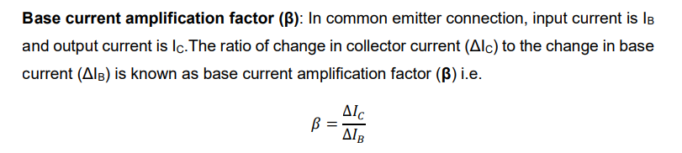

Slide 29


Slide 30
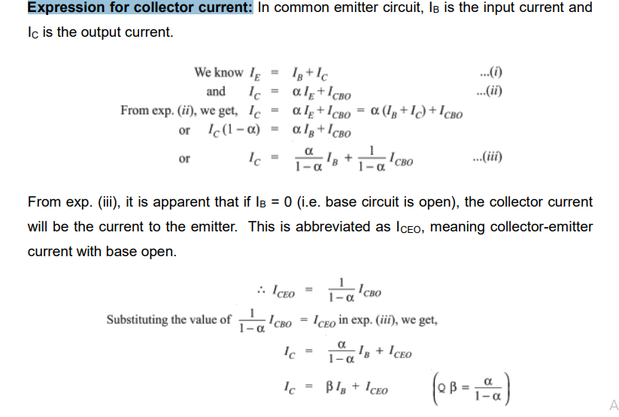

Slide 31
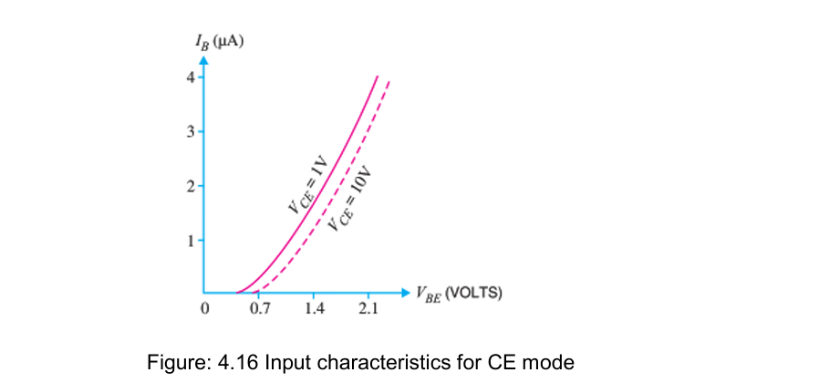
Characteristics of Common Emitter Connection:

Slide 32
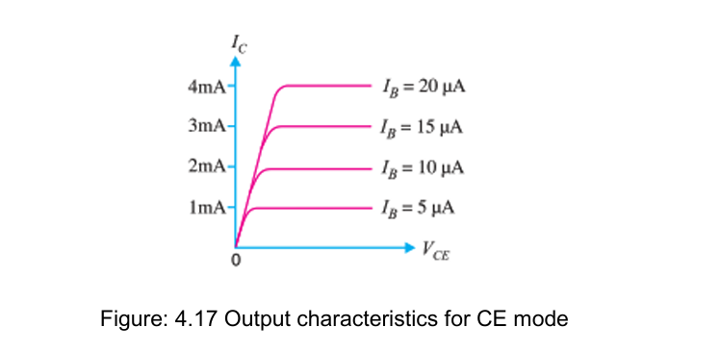

Slide 33
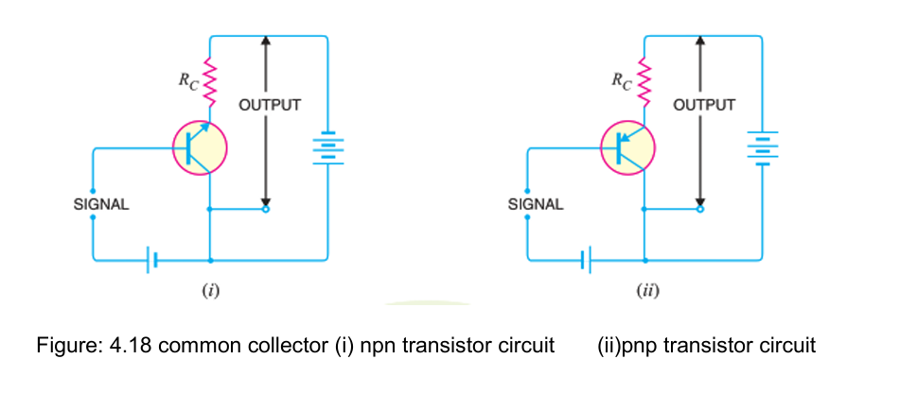
Common Collector Configuration

Slide 34
In this circuit arrangement, input is applied between base and collector while output is taken between the emitter and collector.
Here, collector of the transistor is common to both input and output circuits and hence the name common collector connection.

Slide 35


Current amplification factor (𝜸):

Slide 36
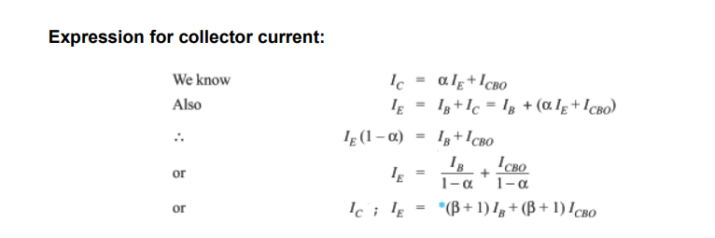

Slide 37
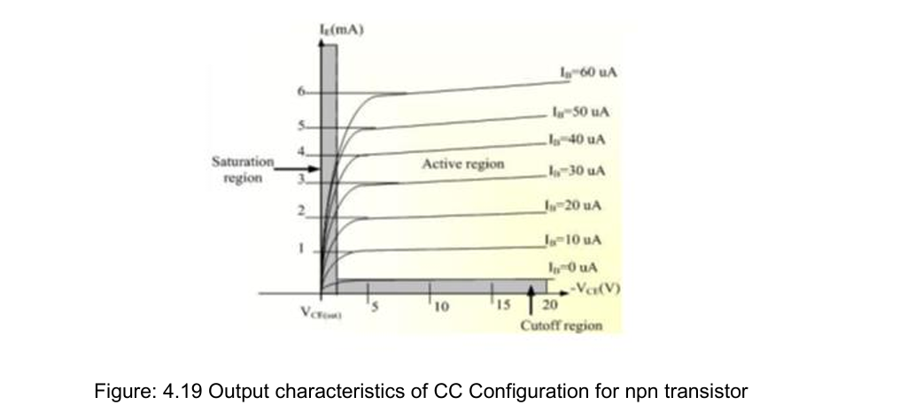

Slide 38
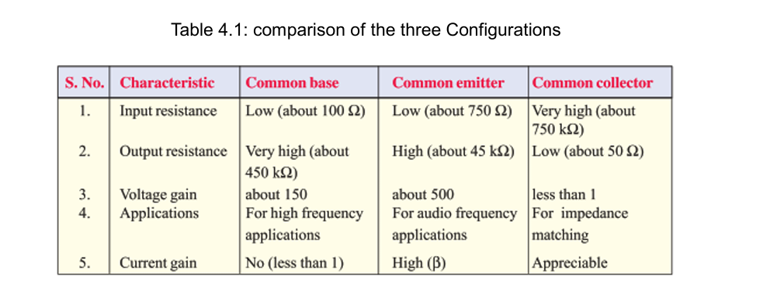

Slide 39
When used as an AC signal amplifier, the transistor’s Base biasing voltage is applied in such a way that it always operates within its “active” region, that is the linear part of the output characteristics curves are used
However, both the NPN & PNP type bipolar transistors can be made to operate as “ON/OFF” type solid state switch by biasing the transistors

Slide 40
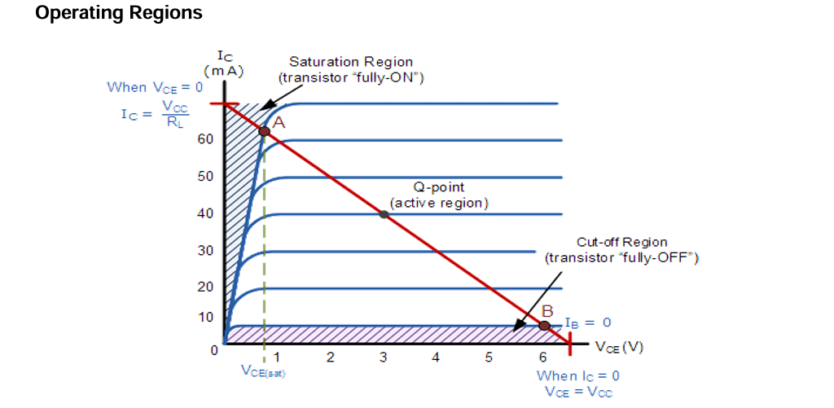
BJT As A Switch

Slide 41
1. Cut-off Region
Here the operating conditions of the transistor are zero input base current ( IB )
zero output collector current ( IC ) and maximum collector voltage ( VCE ) which results in a large depletion layer and
no current flowing through the device. Therefore, the transistor is switched “Fully-OFF”.

Slide 42
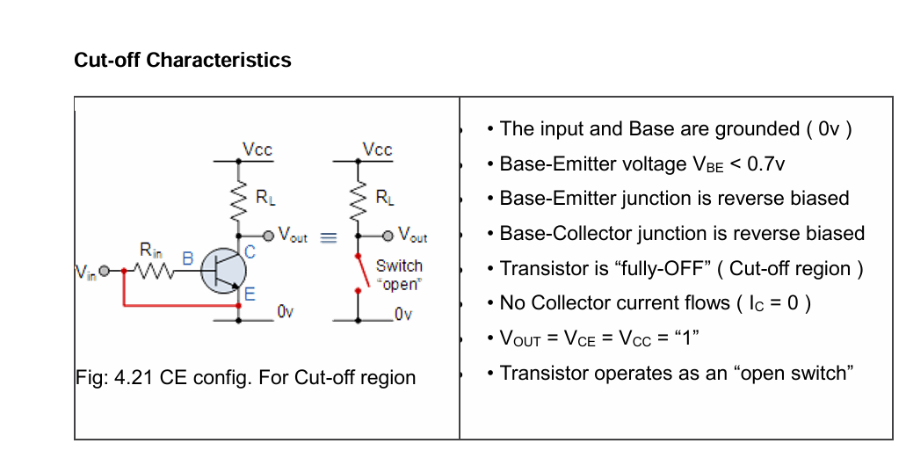

Slide 43
Saturation Region
Here the transistor will be biased so that the maximum amount of base current is applied,
resulting in maximum collector current resulting in the minimum collector emitter voltage drop which results in the depletion layer being as small as possible
and maximum current flowing through the transistor.
Therefore, the transistor is switched “Fully-ON”.

Slide 44
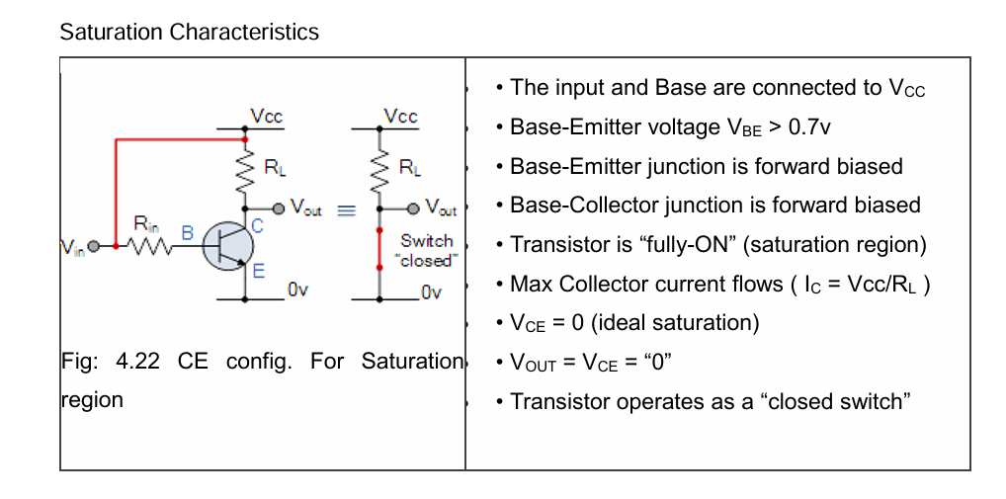

Slide 45
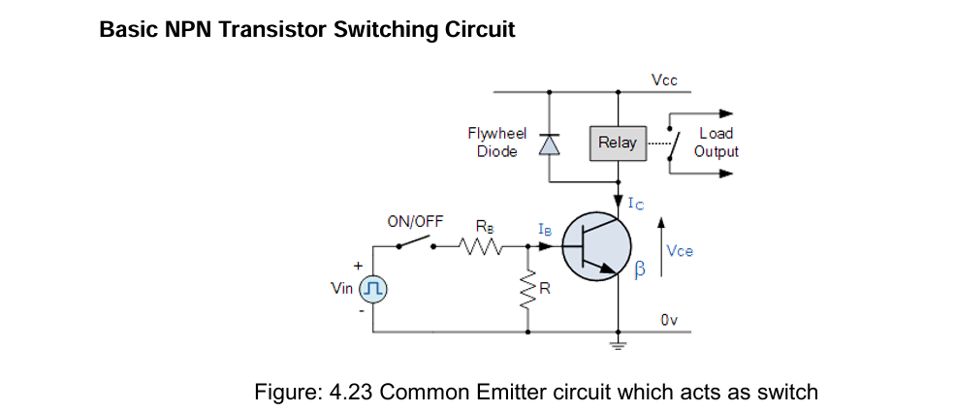

Slide 46
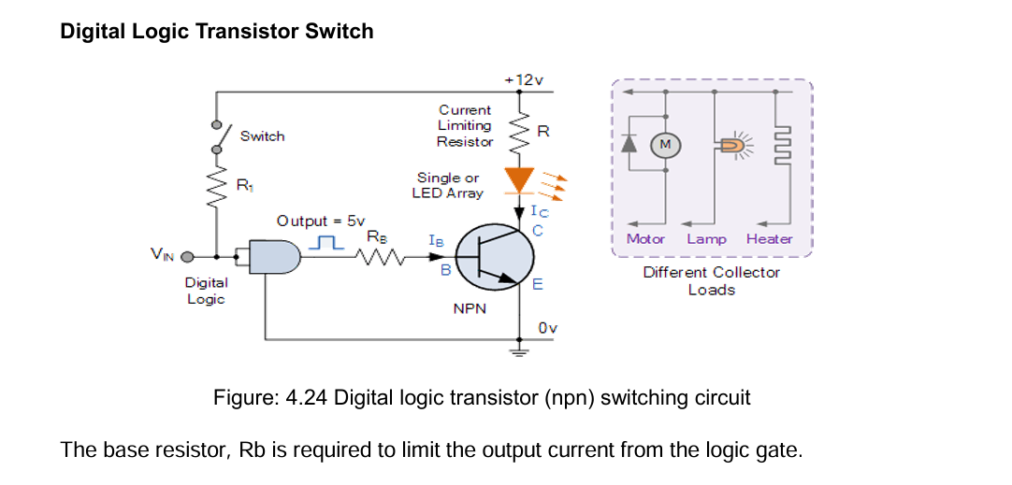

Slide 47
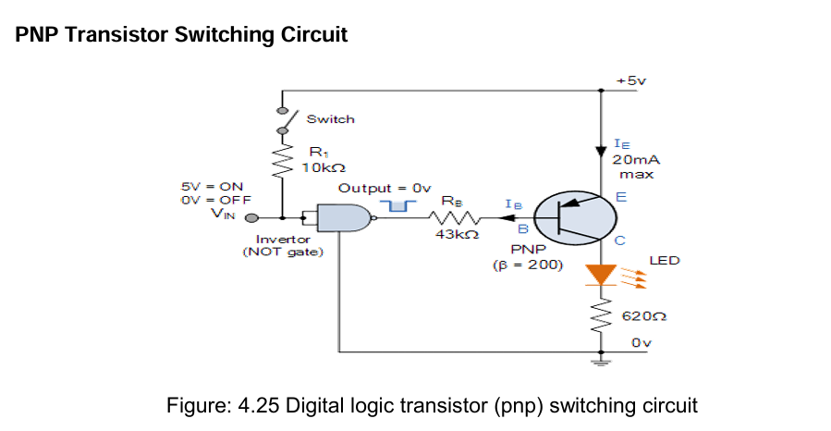

Slide 48
The equations for calculating the Base resistance, Collector current and voltages are exactly the same as for the previous NPN transistor switch.
The difference this time is that we are switching power with a PNP transistor (sourcing current) instead of switching ground with an NPN transistor (sinking current)

Slide 49

Feedbacks of Amplifier
A feedback amplifier uses feedback from the output of the amplifier back to the input to enhance its performance.
it can be either positive or negative.
Gain Stability Relation:
The gain of a feedback amplifier is defined as the ratio of output voltage with respect to the input voltage of a circuit.

Slide 50
Principle of Feedback Amplifier
A feedback amplifier generally consists of two parts. They are the amplifier and the feedback circuit.
The feedback circuit usually consists of resistors. The concept of feedback amplifier can be understood from the following figure.
From the above figure, the gain of the amplifier is represented as A.
the gain of the amplifier is the ratio of output voltage Vo to the input voltage Vi.
the feedback network extracts a voltage Vf = β Vo from the output Vo of the amplifier.

Slide 51
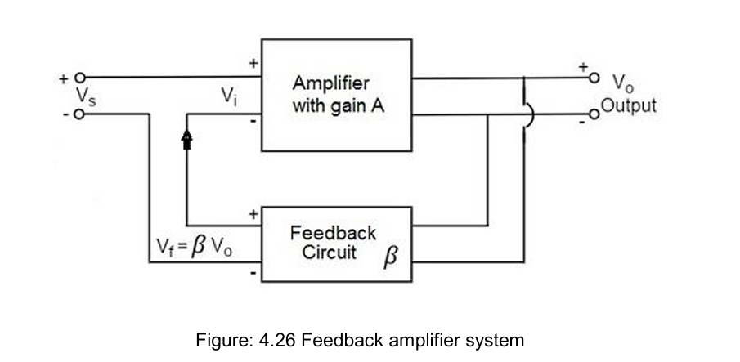
Feedbacks of Amplifier

Slide 52
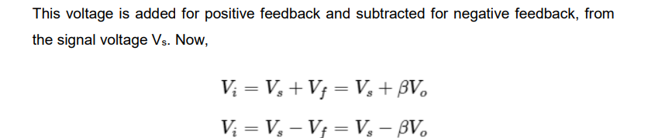

Slide 53

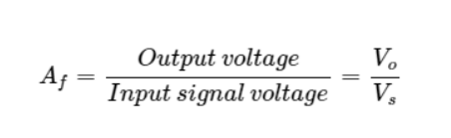

Slide 54
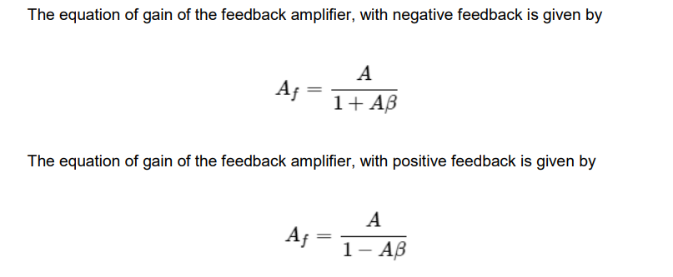

Slide 55
Types of Feedbacks
Positive Feedback
Negative Feedback
Positive feedback:
The feedback in which the feedback energy i.e., either voltage or current is in phase with the input signal and thus aids it is called as Positive feedback.
Both the input signal and feedback signal introduce a phase shift of 180o thus making a 360o resultant phase shift around the loop, to be finally in phase with the input signal.
Negative feedback :
The feedback in which the feedback energy i.e., either voltage or current is out of phase with the input and thus opposes it, is called as negative feedback.
negative feedback, the amplifier introduces a phase shift of 180o into the circuit
the feedback network is so designed that it produces no phase shift or zero phase shift. Thus, the resultant feedback voltage Vf is 180o out of phase with the input signal Vin.

Slide 56
Feedback Amplifier Topologies
1. Current series feedback amplifier
2. Voltage series feedback amplifier
3. Current shunt feedback amplifier
4. Voltage shunt feedback amplifier

Slide 57
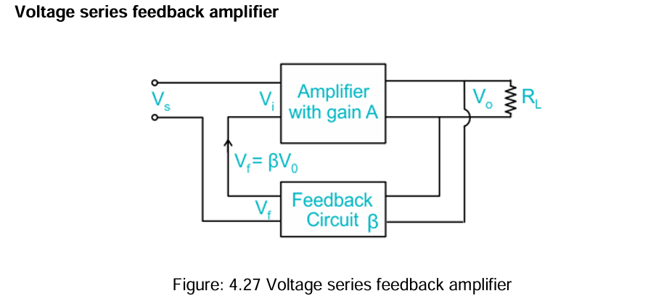

Slide 58
The feedback circuit is connected in shunt with the output in such a way that it decreases the output impedance and increases the input impedance.
In this circuit, it is placed in a shunt with the output but in series with respect to the input signal.

Slide 59
Oscillators
Definition: Any circuit which is used to generate ac voltage without ac input signal is called an oscillator.
The oscillator circuit is received energy from a DC source to generate AC voltage.

Slide 60
Classification of Oscillators:
[1]Based on the wave forms generated:
(a) Sinusoidal oscillator
(b) Relaxation oscillator

Slide 61
Sinusoidal Oscillator:
If the output voltage of the oscillator circuit is a sine wave function of time, the oscillator is called as a Sinusoidal oscillator or Harmonic oscillator.
Sinusoidal Oscillator:
if the output voltage of the oscillator circuit is a sine wave function of time, the oscillator is called as a Sinusoidal oscillator or Harmonic oscillator

Slide 62
Conditions for Oscillation: (Barkhausen Criterion)
1. |Aβ| = 1, ie, the magnitude of loop gain must be unity
2. The total phase shift around the closed loop is zero or 360 degrees. The condition |Aβ| = 1 is the ideal condition.

